Slide 1

KEEP
CALM
AND
GET
HEALTHY
Stress and the Mindbody solution; Releasing Trauma

Slide 2

About me
Patricia Worby
Biochemistry/pharmacology graduate,
postgraduate health researcher.
Despite a ‘good diet’ I had asthma, allergies, depression,, migraines, skin cancer, then CFS/joint swelling..
Tried Chinese medicine in desperation - worked in 3 days!
Changed my mind. Studied: Nutritional medicine, Clinical massage, Reiki, EFT, and Hypnotherapy.
Now a natural health practitioner, wellbeing coach, specialist in chronic pain e.g. anxiety, back pain, auto-immune, CFS, Fibromyalgia, etc.
www.alchemytherapies.co.uk
Notes:
How many of those problems can you relate to?
Then I lost a family member to colon cancer at 49..
Testimonial – clients in the room!

Slide 3
Today..
A holistic definition of health
Stress and its effects on the body
Trauma and pathological memory formation
Psycho-sensory solutions
Demo
Bringing it all together; treating chronic disease & dysfunction
Are you ready to transform your wellbeing?
Notes:
Demo if time. Many of you have asked me how I work so I will be describing that at the end if that’s ok – I would also as if you leave questions at the end if that’s ok when I will be available at the back of the room
Are you ready for that?

Slide 4
Health definition
Health is a state of complete physical, mental and social well-being, and not merely the absence of disease or infirmity.
World Health Organization, 1948
Is a continuum not an all or nothing state.
Is pro-active – you need to do something to support the body to be healthy
Is holistic – mind, body and spirit are all involved. To properly heal must approach all 3.

Slide 5
Natural medicine vs conventional Western
Natural | Conventional
Works with body to by strengthening natural defences i.e focus on health | Target-driven approach – e.g. ‘magic bullet’, etc. Focus on disease
Deals with causes –treat underlying root causes of disease using natural interventions on mind, body and spirit | Deals with symptoms – suppression or ‘management’ via predominantly pharmaceutical and surgical means
Empowers person to heal themselves; Treats person not the disease | Gives over power to medical ‘experts’; Treats disease regardless of person
Requires commitment and taking responsibility for oneself | Allows person to avoid responsibility and ‘keep taking the tablets’
Good for chronic illness where disease is ideopathic* and multifactorial | Good for acute illness e.g infectious disease with clear single target
Notes:
* = of unknown cause. Of course it is not of unknown cause it is usually the same 3 factors; genetic predisposition, environmental trigger (toxicity, stress and lack of essential nutrients) and poor detoxification mechanisms. But it it ‘unknown’ to current medical science as their focus is so narrow.

Slide 6
Stress and the Body
Stress is necessary – it gives us drive and stimulation. It is excess chronic stress (cortisol) that is bad - very common
Conscious stressors: Acute – accident, sickness, divorce
Unconscious stressors – Chronic; -poor diet*negative beliefs, childhood programming, toxic thoughts, bad relationships, traumatic memory, negative emotions.
Cause the most damage.
Mediated by the autonomic nervous system
  *gut dysbiosis and leaky gut is endemic and has serious neurochemical effects via the gut – depression (low serotonin)
Notes:
gluten intolerance

Slide 7
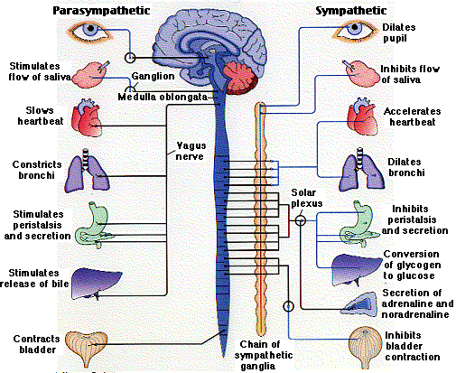
Autonomic nervous system
The Mind and Body link
PNS
SNS
Notes:
Origin of unconscious control and feedback of body and mind. Usually in balance but with constant stress or trauma/ SNS is activated most of the time.

Slide 8
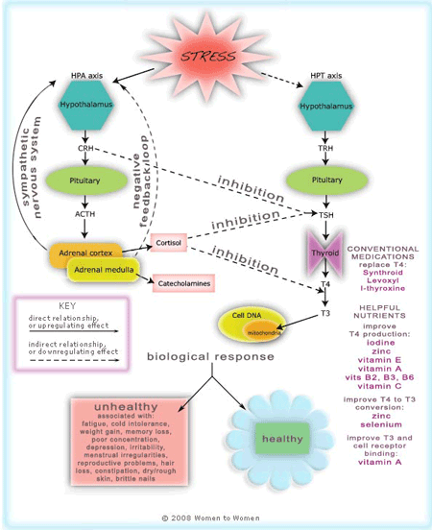
The Stress Response – activates the HPA axis of the sympathetic nervous system – activate adrenals and thyroid
A stressor is anything that takes the body out of homeostasis
Notes:
A cascade of hormonal, neurological and physiological effects

Slide 9
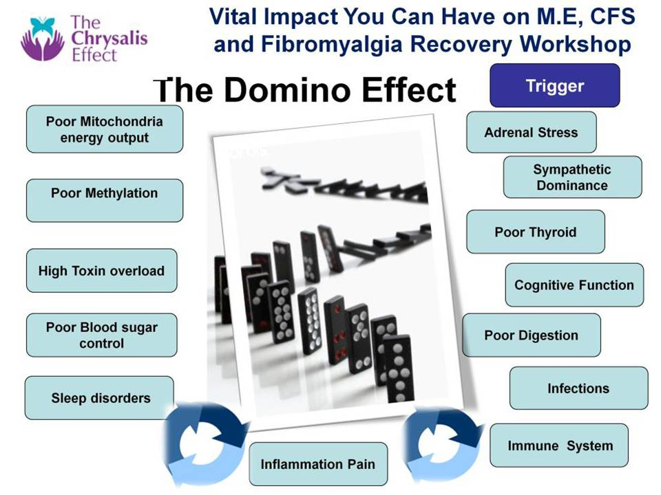
The Anxiety Loop
Anxiety/ Trauma memory
Helplessness
Illness/Pain/ Diagnosis
Heavy metal poisoning
Poor breathing
Notes:
A cascade of hormonal, neurological and physiological effects including the sex hormones, neurotransmitters, etc. e.g NA affects serotonin uptake.
Low adrenals affects thyroid which slows everything down. – digestive complications. IBS, Candida overgrowth, parasites, etc. Food intolerances can develop. As major part o f immune system is inside gut then it will become compromised – get inflammation and pain (auto-immune). Sleep also gets affected due to cortisol imbalance – is low in morning (should be high) and high in evening (when should be declining). Comfort eating/ quick fix with sugary foods /caffeine to keep energy going. Liver gets overloaded with toxins; hormones, heavy metals etc all need to be detoxified.

Slide 10
The Anxiety Loop; the Mind-Body connection
So autonomic regulation is not a one-way street ….
Hormonal, neurotransmitter, neuropeptide regulation is ongoing and interdependent
Every cell in your body contains neuropeptide* receptors and there is constant feedback between the organs (esp. the gut and your brain)
Your cells know if you’re happy or sad, what you think changes the cellular environment and vice versa
Anxiety over symptoms keeps you stuck in sympathetic dominance
The distinction between mind and body is artificial
* Candace Pert, Molecules of Emotion

Slide 11
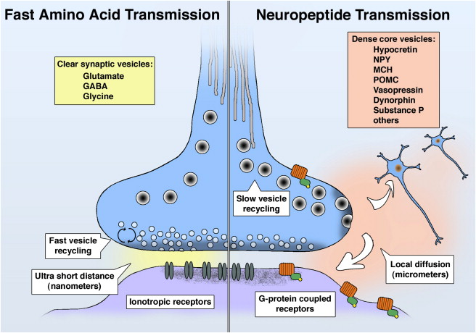
The Mind-Body connection; Neuro-peptides & transmitters
A lot of neurotransmitters are in your gut e.g. serotonin so they are not just a brain – body connection but a constant interplay.
What triggers these to become imbalanced? Stress & trauma are major contributors – threat to survival

Slide 12
Threat response
When under threat an mammal will
1/ seek attachment (parasympathetic – smart vagus)
2/ then escape (fight or flight) (HPA – sympathetic nerve) and finally, if all else fails
3/ ‘freeze’ response* (unmyelinated vagus – reptilian parasympathetic
Mediated by the autonomic nervous system which is unconscious (out of conscious awareness)
Result of this if it is undischarged = trauma; an unresolved emotional threat to our survival
*Children are particularly susceptible because they cannot flee and women are much more vulnerable to freeze
Notes:
Trauma then is not just injury as you may have been led to understand. It is defined in the brainMyelin is the sheath that surround nerve fibres and is responsible for making the nerve impulses go faster – it is like an insulator. Without myelin nerve impulses are much slower – fishlike in fact!

Slide 13
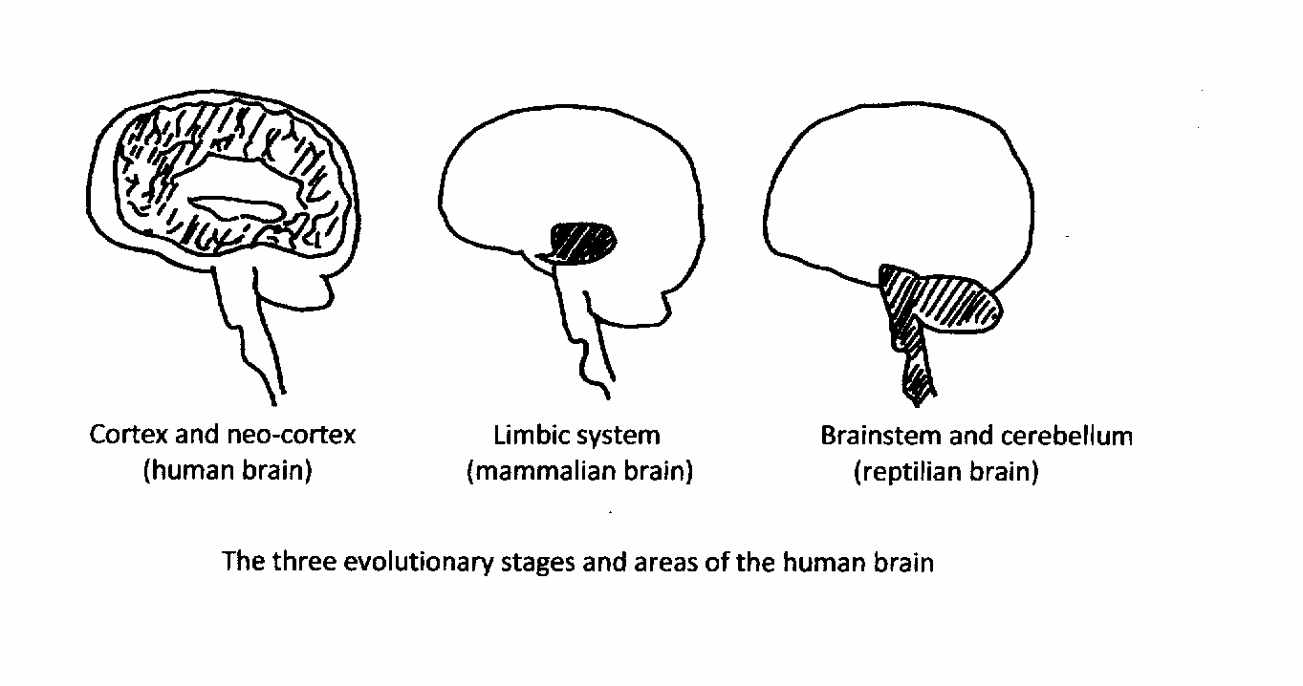
The Triune Brain: origin of unconscious threat
subconscious - we are not aware of them;
our survival mechanism – 90% our function
Notes:
We think we are mostly driven by our thinking brains, in fact this is not true. We are mostly driven by subconscious stimuli processed by the survival part of the brain – brainstem and limbic system

Slide 14
Trauma: Definition
Any unresolved event pathologically /permanently encoded causing emotion/symptoms in the present
Can be physical (e.g. accident) or psychological e.g. abuse. Usually in childhood/young adulthood, linked by emotions & memory in the subconscious mind
The meaning we attribute to the event not the severity of the event itself. So can be simply lack of love/support, feelings of abandonment, etc. Helplessness is the trigger.
Trauma = Unresolved emotional memory
Notes:
Not what is medically defined as being a physical trauma to the body such as afrom an accident. Has a much broader spectrum than this.

Slide 15
Traumatic memory formation
Event
No escape possible
Thought/ belief e.g. I’m not safe
Sensation e.g. pounding heart, clock ticking, etc
Emotion e.g. fear
Stored in limbic system
Notes:
If occurs in childhood before the cortex is operational and can analyse the context, is stored in the amygdala & hippocampus (Limbic system) with its associated sensations, thoughts and emotions. Perceived inescapability must be present.
Event + intense emotional response with a sense of helplessness (i.e no escape/safety)
The memory is permanently encoded with alarm as we are hardwired to respond to aversive stimuli with fight, flight or freeze. Where first 2 not possible, trauma (undischarged freeze) results.

Slide 16
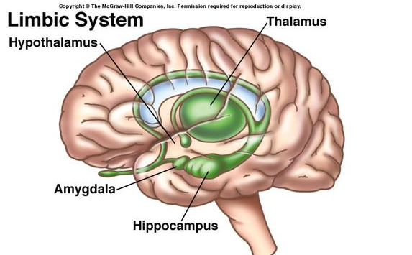
The Emotional/
Mammalian Brain
Where traumatic memory is stored
Notes:
Consists of deep brain structures the hypothalamus (from SNS) Thalamus, Amgygdala and hippocampus. There last two are the most important for trauma formation.

Slide 17
Why is trauma important?
Any resulting event which triggers the same emotion will result in compounding and a re-experiencing of original emotion - overwhelm
The more trauma you have the more cumulative emotional charge and the more disabling it will be. Affects personality and behaviour to a huge extent.
Trauma is persistent, present and pervasive
As it is stored in procedural memory it becomes a self-perpetuating cycle of internally generated subconscious stress which makes further trauma more likely - kindling
Symptoms: depression, anxiety, panic attacks, poor eyesight, chronic pain (e.g back pain, TMJ, whiplash, Chronic Fatigue)*.
*Trauma heightens sensitivity to physical pain neurologically (Howard 2000) and is associated with development of persistent (chronic) pain (Hart-Johnson & Green 2012)
Notes:
Interestingly animals exhibit all these reactions too but with the freeze response they are seen to discharge it afterwards with shaking. We do that too – after shock for instance but often in childhood this discharge is not possible and trauma results.
Chronic back pain which is not related to anatomical/structural defect often is a post-traumatic symptom
TMJ – temporo mandibular joint syndrome. Clicking, grinding of teeth, pain in jaw, etc. common after bereavement, accident, etc.
Whiplash is so much more than physical trauma!
*Trauma heightens sensitivity to physcial pain neurologically (Howard 2000)

Slide 18
Trauma = Unresolved Emotional memory
Emotions are just feeling states made from neural connections. Most are habit-based.
Reactive: fear and defensive rage – primitive, hardwired
Routine: happiness, surprise, anger, etc – learned and fleeting in prefrontal cortex.
Reflective: require conscious thought e.g. shame, guilt, grief, jealousy, etc. Long-lived and can be traumatically encoded in the limbic system (amygdala and hippocampus)
Notes:
Routine emotions are short lived and often fleeting, transforming into others quickly.
Reflective emotions are the most long-lived and potentially damaging as they can be traumatically encoded and can therefore last a lifetime causes pain and dysfunction. Shame is particularly damaging.

Slide 19
Emotions are stressors
Reactive and Reflective emotions do not diminish over time and produce chronic inescapable stress
Appetitive needs e.g. attachment, food, water and sex promote drives which, if unmet, also cause stress. Addictions can therefore form.
Both are evolutionary adaptations - ↑survival
Both affect memory, perception, thought and action via evaluation of the prefrontal cortex.
Notes:
A permanent imbalance in the brain. Sets the stage for further traumatisation and generates symptoms that are maladaptive.
Appetitive survival system has similar goals – both increase our chances of survival. Meeting these needs increases pleasure and is cyclical.
In addictions, abnormal appetitive drives result from traumatized reactive or reflective emotions.

Slide 20
Nature of Emotions - Fear
Can be motivating /enhance decision-making (diminish choices) and help memory retrieval (in short term)
Most ancient emotion, hardwired. Conserved through evolution
Survival mechanism to encode fear-producing memories to avoid predation
Amygdala directs hippocampus to store and retrieve encoded memories for ready retrieval
Indirect (learnt) information can also be encoded as trauma e.g if your mother says it’s unsafe or she screams when she sees a spider i.e. a learned response
Notes:
Emotions facilitiate the storage of memory making it easier to retrieve. But also modulate formation of association to events.
They have deep survival value modulated by neurochemicals. However, if maladapted can cause traumatisation.

Slide 21
Traumatisation
When an event happens before the hippocampus becomes active @age 3-4 are stored in procedural memory – sense feeling, no cognition. Or emotionally charged implicit memories at a later stage – you can’t explain them
Our behaviour is largely driven by these early events in procedural memory.
If they are traumatised memories (i.e. with helplessness) they will be stored below conscious awareness and never fade
Notes:
Procedural memory is the earliest memory system associated with experiencing a ‘sense feeling’ i.e a feeling with sensory input but without cognitive content, e.g smell of perfume, perception of body posture, etc and enable us to food in our mouths, crawl and speak. But will also house abandonment or abuse memory if before ages 3-4 before hippocampus is active.

Slide 22
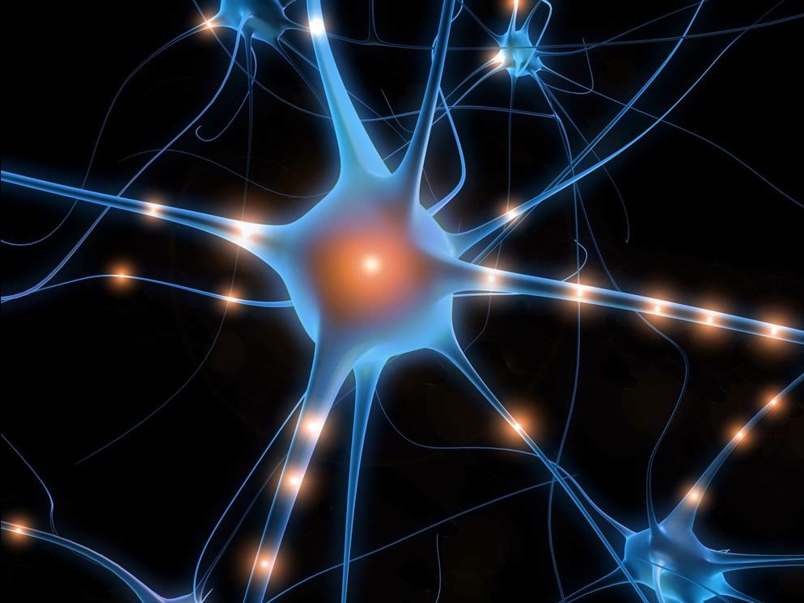
Consolidation
A memory is stabilised by encoding of the memory trace – consolidation of neural pathways
In traumatisation the memory becomes permanently encoded in the amgydala
i.e. when triggered by similar events, you re-experience the emotions as if they were today. Mediated by neurotransmitters glutamate, noradrenaline, cortisol and dopamine.
Notes:
This is is a theory expounded by Ronald Ruden in his book P36.
Synaptic Consolidation occurs when neuronal pathways connected by glutamate receptors are laid down during the event.

Slide 23
Trauma spectrum – no trauma?
‘Big T’ trauma – life-threatening situation e.g. abuse, accident, unresolved loss, operation, etc
‘Little t’ trauma – many childhood experiences – not always thought of as trauma at the time. Any emotionally charged experience which you interpret as inescapable e.g. your parents argue, you are blamed for something, bullying, etc
Affects autonomic nervous system causing addictions, chronic pain, panic attacks, depression, insomnia (hypervigilance), irritability, procrastination, mutual dependency
Notes:
Trauma’s may not be preceived as trauma at the time.. But it is the meaning you attribute to the event not the severity of the event which has power.
Affect ANS and sets it in sympathetic dominance.

Slide 24
Traumatising Event
Event
No escape possible
Thought/ belief e.g. I’m not safe
Sensation e.g. pounding heart, clock ticking, etc
Emotion e.g. fear
All create negative cognition = belief about self at time of event
NC is based on the emotion not on the data about the event itself. Therefore changing your thinking has limits.

Slide 25
Neurobiology of trauma
Talking about it doesn’t change the way the memory is stored. i.e. changing thinking (‘cognitive restructuring’ not so effective for trauma).
Need to work at the level of emotion, engage emotion to fire neural pathways
These maladaptive memories are:
  Associative
  Cumulative
  Frozen (this is the difference with mal/adaptive)
  Painful – overload! the past gets stored in the present
But you may not be aware why – it is unconscious
Notes:
You will remember one to the other, they will build and they are stuck

Slide 26
Why we struggle
Body locked into ‘fight and flight’ – sympathetic dominance - mental & physical illness
Feel ‘stupid’ and embarrassed, weak, vulnerable, shame
Have a low tolerance for frustration, slow changes
Avoid things that trigger or re-enact rather than resolve
Adopt ‘learned helplessness’ – lose faith we can change.
Dissociate /freeze, not even in touch with emotions.
We fear change. We dig our heals in – ‘resistance’ and carry on doing what we’ve always done. Habit
Notes:
We are habitual beings – once a habit is ingrained it is the path of least resistance and we repeat it over and over.

Slide 27
The 3 pillars of treatment
Psychotherapy: talking therapy which aims to understand origin of problem and in ‘re-framing’ it to resolve it. Largely unsuccessful.
Psychopharmacology: symptom suppression with pharmaceuticals. Limited success.
Psychosensory: use of sensory stimulation to re-configure the brain’s response to stressful memory. Moderate to Extraordinary success!

Slide 28
Psychosensory therapies
A mindbody approach - does not distinguish between mental and physical response. We are both and they are intimately connected. We use the notion of neuroplasticity - constant re-wiring from birth onwards
Two types, those that require:
  Memory activation prior to treatment (exposure therapies) and disrupt the connection between memory and emotion e.g EFT, EMDR - desensitisation
  Those that require the mind at rest (downregulate the stress response and its effect on information processing) e.g. massage, cranio-sacral, acupressure, mindfulness
Notes:
Our personality and response to things is a result of the plastic formation of the brain from conception onwards. The mileu of the brain while in the womb is important as is those first few years while the brain is still forming. Neuroplasticity is constant however –even in adulthood.

Slide 29
Treatment: reactivation and re-consolidation
Reactivation of these glutamate pathways during recall of memory makes these pathways alterable
Neurons that ‘fire together wire together’
If some form of havening then occurs during recall (touch or other sensory stimulation) the memory and its emotion can be dissociated – extinction
In order to heal:
we need to make the unconscious conscious
Notes:
Makes the pathways susceptible to disruption

Slide 30
Psychosensory approaches
EMDR – Eye movement desensitisation and Reprocessing- Bilateral stimulation
EFT – Emotional Freedom Technique – tapping with self-affirmation
Havening – eye movements and self soothing
Hypnotherapy – e.g. Lightning process – hypnotherapeutic intervention

Slide 31
EMDR used for:
Panic Attacks
Trauma
Physical Abuse
Anger
Relationship issues
Limiting beliefs
Usually in combination with counselling, coaching or hypnotherapy

Slide 32
How does EMDR work?
Several theories:
Bilateral stimulation – right and left hemispheres resolves and integrates memories in midbrain (limbic system). Like in REM sleep – memory is ‘pruned’ & digested. De-arousal of watching boring sensory stimuli right to left hemispheres via dopamine
Change memories from implicit to explicit (you remember the association)
Maladaptive links into adaptive network (facilitates insights), becomes less volatile
But basically brings the cortex (frontal lobe) online and allows processing of the thought/emotion.
Notes:
2 Theories; bilateral stimulation like REM sleep
Or working memory hypothesis

Slide 33
EMDR
Is not hypnosis – no trance state
Is self (brain) directed – figures out where it needs to go
Is not just a technique (is a treatment modality) – work within a framework/plan with a strategy
Agree goals, predict results
Teach and train afterwards
Is ‘mindfulness on steroids’
Like REM sleep – processes (‘prunes’) thoughts
Notes:
Reprocesses memory to resolution. Trauma disrupts this process. Nightmares also disturb the process. Hence dreams are very important and can be targets for EMDR – can reveal what the actual experience is.

Slide 34
Demo
Full history assessment
State change/safe place exercise
Find targets/touchstone events/troubling memories
Locate feeling in body– rate SUDS*
Bilateral stimulation (movement of therapists fingers left to right) – focus on feelings, thoughts, memories
Stop; what do you notice? Discuss. Take a deep breath.
Start again – repeat 3 or 4 times until SUDS = 0
Close-summarise. Bring in positive cognitions, summarise learning.
*Subjective Units of Distress

Slide 35
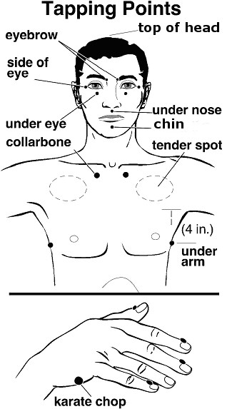
EFT – Emotional Freedom Technique
Developed from treatment for victims of post-traumatic stress disorder PTSD
‘energy psychology’ intervention which re-wires the brain
Taps on the head and neck while focusing on the problem to be treated and repeating the ‘set up phrase’ until the emotion around the thought it released.
Has remarkable results!
Notes:
EFT. Set up phrase includes psychological reversal so that the brain must agree.

Slide 36
EFT - how does it work?
‘Even though I have this [state problem] I deeply and completely accept myself anyway’
Good for cravings, bad habits, exam nerves, weight loss and control, mild trauma, eyesight!
Self-care – for doing at home or before difficult situations
Chase the problem – other things will arise.
How it works:
  Energy meridians – gets the flow going again (Eastern)
  Neurological re-wiring (Ruden – Western)
  Memory coding (linked with eye movements - Western)
Notes:
Robert Ruden

Slide 37
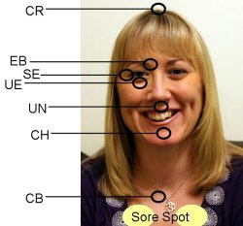
Demo - EFT

Slide 38
Hypnotherapy
Uses the power of your imagination to desensitise and rehearse difficult situations (unconscious processing – 95% of brain function).
Re-wire the brain by distracting the frontal lobe, reducing the thinking centres and allows reprogramming of emotional brain.
Is profoundly powerful, experienced as relaxing but in fact is doing deep work
NOT mind-control – you are always conscious

Slide 39
References
Peter Levine - In an Unspoken Voice, how the body releases trauma and restores Goodness' (latest) and 'Waking the Tiger' (his classic)
James Alexander- The Hidden Psychology of Pain
Robert Sapolsky - Why Zebras don't get Ulcers
Robert Scaer - The Trauma Spectrum
Ronald Ruden - When the Past is Always present
Dr John Sarno - The Mindbody Prescription
Dr James Alexander -The Hidden Psychology of Pain
Prof. Martin Seligman - Learned optimism & What you can change and what you can’t
+ for an exhaustive account of the stress response: http://physrev.physiology.org/content/87/3/873

Slide 40


Thank you for listening
Thanks to all my clients, who are my best teachers..
Clinics
Peartree (home)
Central (Orchard therapies, London Road)
Portswood (Spring Chiropractic)
Patricia Worby MSc. ACMT, HPD, GHR
@patriciaworby
Patricia Worby Holistic Health/Alchemy

